Slide 1
Local Values
OW

Slide 2
Overview
In Terraform, local values are used to define intermediate values within a configuration that can be reused multiple times.
Local values are similar to variables, but they are not meant to be passed as input or configured externally.
They are internal to the configuration and are primarily used to simplify expressions, enhance readability, and avoid code duplication.

Slide 3
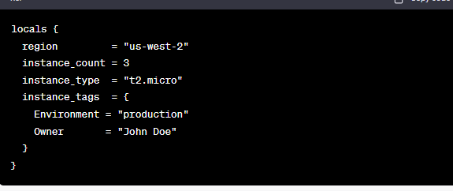
example

Slide 4
..
In this example, we define a locals block that contains multiple local values:
region: Represents the AWS region as a string.
instance_count: Specifies the number of instances as a number.
instance_type: Represents the instance type as a string.
instance_tags: Defines a map of tags for the instances.

Slide 5
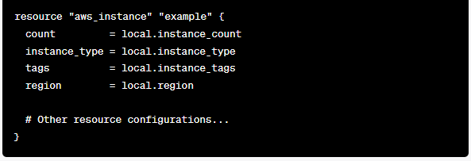
How to use in resource block
In this example, we use the local values within an aws_instance resource block. The count argument is set to the value of local.instance_count, and the other attributes are set accordingly.

Slide 6

Use local values in output block
In this example, we use the local.instance_count value within a range function to generate a list of instance names.

